Slide 1

Note: The data and information in this document is reflective of a hypothetical situation and client. This document is to be used for KPMG Virtual Internship purposes only.
Sprocket Central Pty Ltd
Data analytics approach
[Division Name] - [Engagement Manager], [Senior Consultant], [Junior Consultant]

Slide 2
Note: The data and information in this document is reflective of a hypothetical situation and client. This document is to be used for KPMG Virtual Internship purposes only.
Agenda
Introduction
Data Exploration
Model Development

Slide 3
Note: The data and information in this document is reflective of a hypothetical situation and client. This document is to be used for KPMG Virtual Internship purposes only.
Introduction
customers analysis
Age distributions
Number of bike purchases in 3 years / percentages purchases
Job industry category.
Wealth segments
Number of cars own on each states

Slide 4
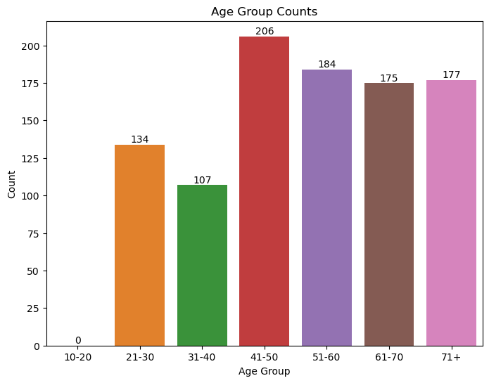
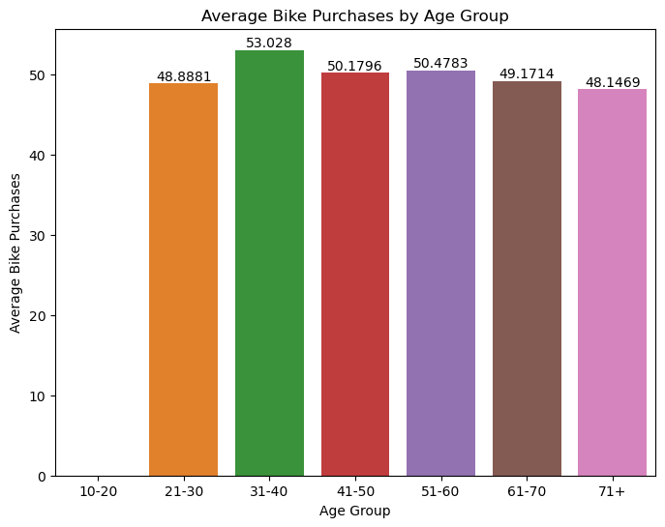
Note: The data and information in this document is reflective of a hypothetical situation and client. This document is to be used for KPMG Virtual Internship purposes only.
Data Exploration
Customers’ age distribution
New customers are more from the age group of 41-50.
Fewer customer are from 10-20 for obvious reasons.
Data shows age group 31-40 has high count in terms of bike purchased in last 3 years with a slightly greater female ratio.

Slide 5
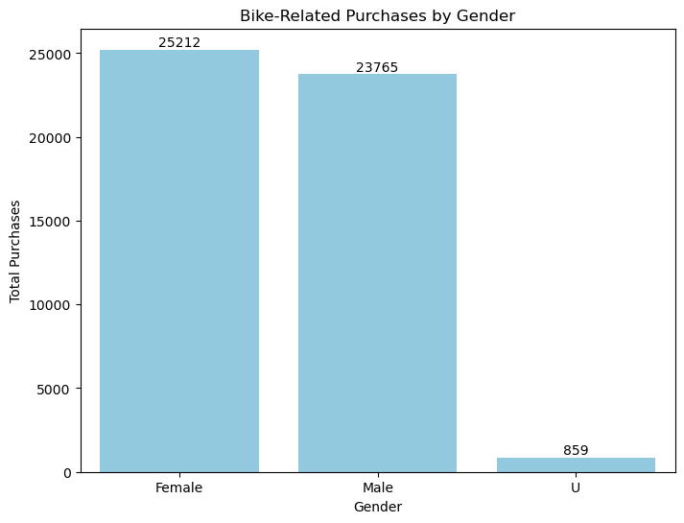
Note: The data and information in this document is reflective of a hypothetical situation and client. This document is to be used for KPMG Virtual Internship purposes only.
Model Development
Bike purchases last 3 years
As we can see, our new customers mostly Female with 50.6% purchases with total of 25,212 bikes
Male contributed to 47.7% purchases with 23,765 bikes
So we should focus on advertises on Female customers than Male customers

Slide 6
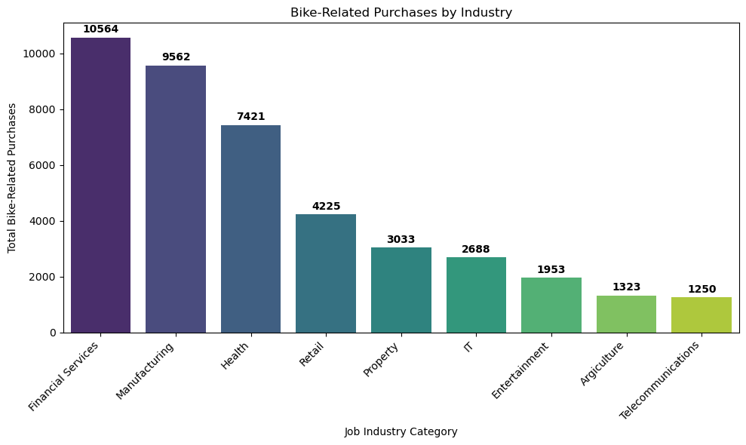
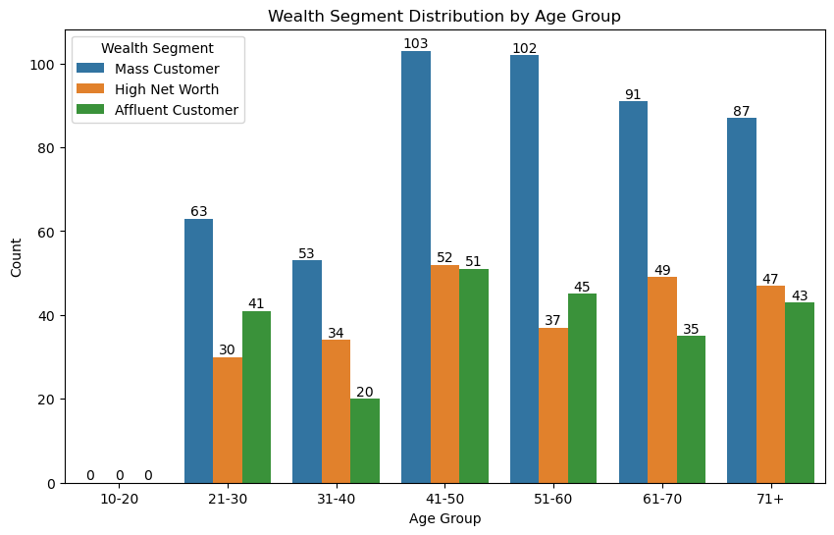
Note: The data and information in this document is reflective of a hypothetical situation and client. This document is to be used for KPMG Virtual Internship purposes only.
Interpretation
Job industry category
Mostly our new customers are on Finance industry and our Manufacturing customers are still on top 2.
The rest industries is still same
Wealth segments
In all ages, the number of Mass Customers is the highest so we should focus on this social class.
After that, we should focus on High Net Customer.
Then Affluent Customers but mostly second and third quadrant

Slide 7
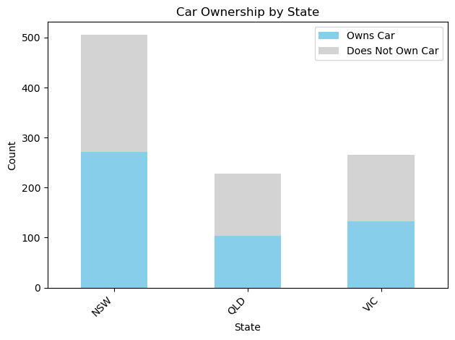
Note: The data and information in this document is reflective of a hypothetical situation and client. This document is to be used for KPMG Virtual Internship purposes only.
Interpretation
Numbers of cars owned
NSW should be considered the most since numbers of customers don’t own cars is significantly larger than that own.
VIC and QLD has more customers that own car that who don’t but we can try to have something so that those owns car will buy bikes.

Slide 8
Note: The data and information in this document is reflective of a hypothetical situation and client. This document is to be used for KPMG Virtual Internship purposes only.
Model Development
CUSTOMER CLASSIFICATION – Targeting High Value Customers
The following are the high-value clients to target from the new list :
Aged between 31 – 40.
Most of the high value customers are female compared to male.
Working in Financial Service, Manufacturing and Health.
Who are currently living in New South Wales and Victoria.

Slide 9
Note: The data and information in this document is reflective of a hypothetical situation and client. This document is to be used for KPMG Virtual Internship purposes only.
THANK YOU!

